Slide 1
The new OIAr
& a cookbook approach
OIAm community day 2015-07-01

Slide 2

Conversation points
Intended use of the OIAr;
Background:
  History of the OIAr;
  Technology of the present day OIAr;
Content – now & future;
Cookbook approach – how does it fit in?
Where to go from here?

Slide 3

Intended use of the OIAr
OIAr stands for: “Open Infrastructure Architecture repository”;
A community repository meant to contain:
  A library of standard content (generic functions, generic patterns, templates);
  Example content (example applied functions / applied patterns / landscape);
  Community content (documents, photos…);
  Information for self-study/research;
Cooperative content creation.

Slide 4


History of the OIAr – the early days
Start 2008 at KLM/AirFrance as architecture knowledge management system;
End of 2008, a copy was made available as a community version at smartmart.nl;
Originally using MediaWiki 1.15 and Semantic MediaWiki 1.3;
“Information Model” helped shape development:
  Generic vs. Applied functions (”type” vs “variant”); Patterns;
2009 hosted at Sogeti as DYA|Infrastructure Repository (DIR);
  (still available at https://dya-knowledge.sogeti.nl/dir)
Content loosely vetted by a community board since 2010.

Slide 5

History of the OIAr – increasing maturity
2012 moved to its current home https://www.infra-repository.org/oiar
“Information model” translated to ArchiMate 2 terms; knowledge model semantically implemented;
Tried and retried different Functions and Patterns;
Technology refresh (MediaWiki 1.21, SMW 1.8);
Generic structure for templates, layouts etc. based on mediawiki.org;
Some obsolete functions and patterns can only be found in the archives
(https://www.infra-repository.org/oiar-2013 or https://dya-knowledge.sogeti.nl/dir).

Slide 6


Content – the library (Generic Functions)
Functions as described on the OIAr are “official”:
  Naming;
  Descriptions;
  Icons;
Actual icons = MS Visio;
Current status: most functions at maturity 3 (usable) or 4 (mature),
nothing at maturity 5 (official) due to community board process;
Organizations can have proprietary functions; may be put forward as proposals (maturity 0) and promoted via community board process.

Slide 7

Content – the library (Generic Patterns)
Patterns described on the OIAr are “official”:
  Naming / descriptions / functional & integration diagrams;
  Composition including rationale;
  Integration including rationale;
  (Pointers for use, integration and best use currently lacking);
Actual diagrams maintained in Archi & BiZZdesign Architect;
  Export in SVG, convert to PNG using Inkscape;
Current status: most patterns at maturity 3 (usable) or 4 (mature), nothing at maturity 5 (official) due to community board process.

Slide 8

Content – the library (Applied Functions/Patterns)
Currently not provided;
Would need to be based on example organization(s):
  Context required to understand architecture decisions;
  Requires much explanation to “make sense”;
  “Many ways lead to Rome” problem;
Cookbook approach for Patterns feasible?
(Applied) Services can inspire Product & Services Catalogues?

Slide 9

Content – the library (Quality Attributes)
Quality Attributes (QAs) themselves stable since 2009;
QA levels crude and under-researched;
Application in practice:
  “Qualitative” discussion of qualities very valuable;
  Application of quality levels in designs not standardized.

Slide 10
Content – the library (Landscapes)
Current “generic” landscape works well as checklist/cheat sheet;
“Applied” landscape for organization(s) may be reasonably simple to create:
  Example organization or (anonymized?) real organizations?
  How confidential/sensitive can an infrastructure landscape be?
  Useful (didactic/operational) tool to counter the “too abstract” claims.

Slide 11
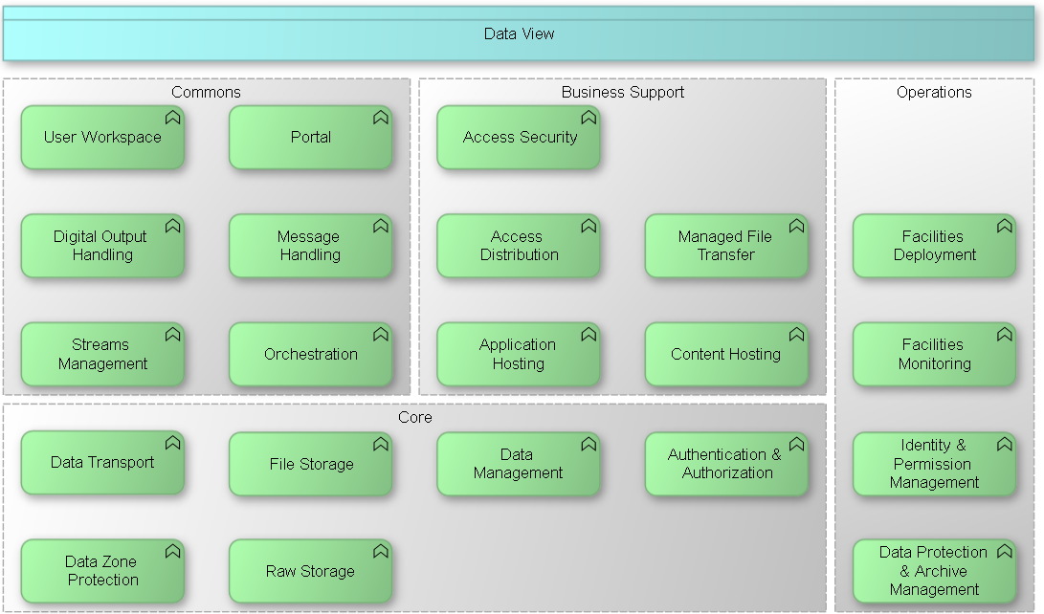

Slide 12
Content – self-study materials
Reproduction of parts of whitepapers and training materials;
Downloads are possible:
  Whitepapers (Blaauw, OIAm Introductory, Requirements Processing, …);
  Future templates? E-Pubs?
Insufficient resources available for structured approach;

Slide 13
Content – community materials
Downloads are possible:
  Community materials (minutes, presentations, photos, …);
  Collaboration materials?
  Brochures/flyers?
  Case studies?
Collaboration platform?
  Wiki possibly not the best form.

Slide 14

Cookbook – difference with “examples”?
Examples – do they work for an architect new to OIAm?
  Context of every organization may/will be different;
  Demarcation of the landscape may differ;
  Challenges confronted may differ;
  Products may not be recognized by the architect.

Slide 15

Cookbook approach – what is it?
Selected generic problems:
  Representative of commonly occurring real-world problems;
  Context as generic as possible;
General solutions:
  Per problem a generic solution;
  Provided solution with a modicum of detail;
  Considerations and motivations surrounding the solution;
  Multiple solutions if warranted by differing contexts;

Slide 16
Cookbook approach – why would it help?
A generic problem akin to the acute problem may be available;
Approach taken to solve the generic problem can be recognized;
Cookbook solution can serve as an outline for the actual solution;
“Easy start” to gain experience using the OIAm method.

Slide 17
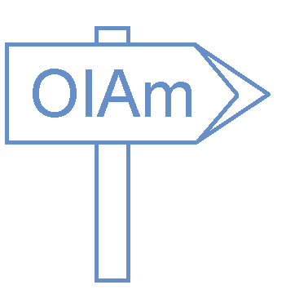
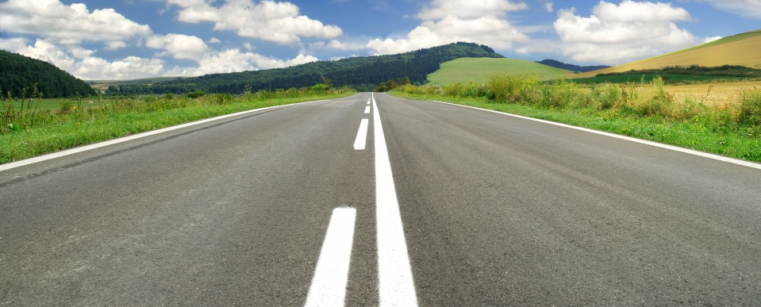
Where to go from here?
OIAr library content needs completion & vetting on Generic Functions/Patterns;
Community involvement in developing materials is required;
Cookbook examples may be developed in educational institutions;
…
Where do YOU think we should go from here?

Slide 18
Thank you

