Slide 1

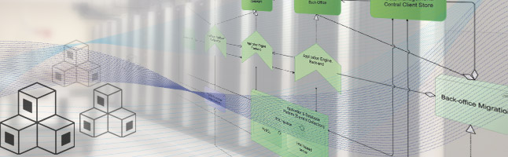
OIAm@Windesheim
OIAm for IT infrastructure students

Slide 2
$ whoami
Bram Abbekerk
Windesheim Applied University
Lecturer HBO-ICT / Infrastructure Design and Security
http://www.windesheim.nl/studeren/opleidingen/techniek/technische-informatica/
mailto:an.abbekerk@windesheim.nl
mailto:bram@abbekerk.demon.nl
$ whoami
David Maas
Student HBO-ICT / Infrastructure Design & Security
$ whoami
Stephan Vorstenberg
Student HBO-ICT / Infrastructure Design & Security

Slide 3

Agenda
A short overview of the “Infrastructure Design and Security” programme
A student reflection on using OIAm in infrastructure design

Slide 4

Windesheim University of Applied Sciences
Knowledge institution for Education, Research and Entrepreneurship
>20.500 students, 1000+ course participants and 2.000 employees
Campuses in Zwolle and Almere

Slide 5
HBO-ICT / Infrastructure Design and Security
Infrastructure Building Blocks
  Operating Systems (Microsoft, Linux)
  Network technology (Cisco)
  Hypervisors (Vmware, HyperV)
Infrastructure Design
  Cloud Automation
  Design & Test methods (Archimate, OIAm, TMap)
Infrastructure Security
  Ethical Hacking (CEH)
  Advanced Information Systems Security (CISSP)
  Network Security
  IT Forensics
Minor | IDS Graduation
IDS Security | Minor
IDS Building Blocks | IDS Design
HBO-ICT propedeuse
IDS intro

Slide 6
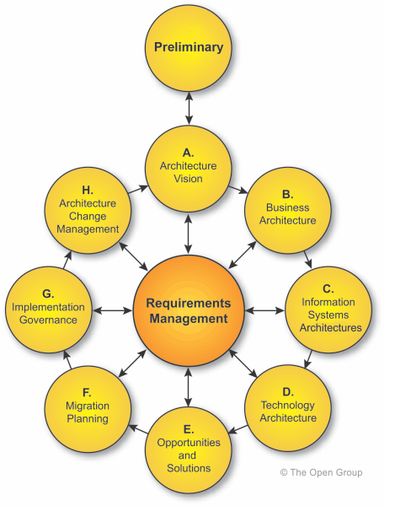
















Design & Test methods
Enterprise Architecture
  TOGAF overview
  Archimate modeling
Requirements analyses and acceptance criteria
Functional modeling
  OIAm
Technical modeling
  Best practices
  Product manufacturer prescription
Risk-based test management
  TMap | Infrastructure overview

Slide 7
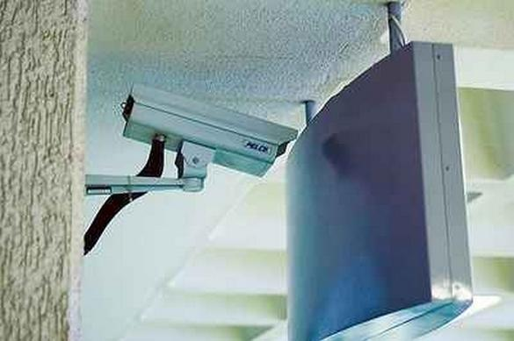
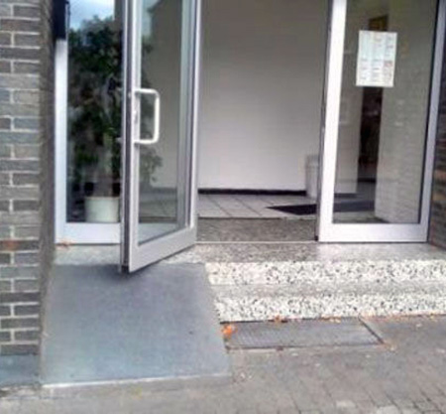
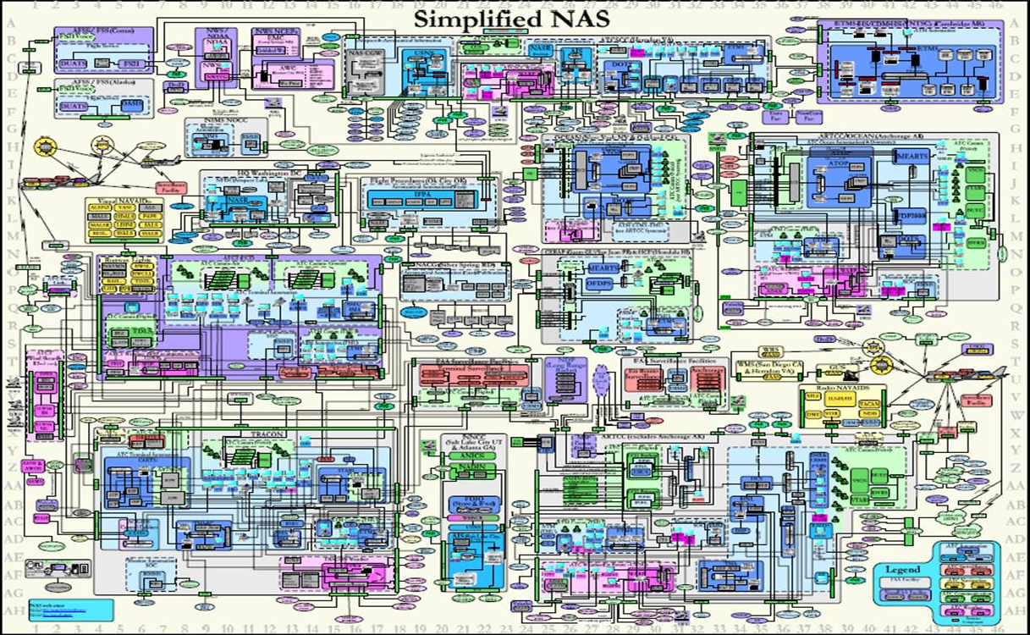
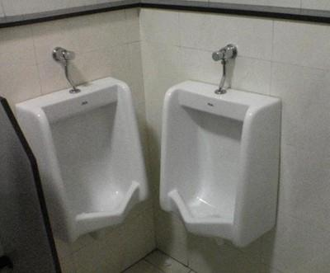
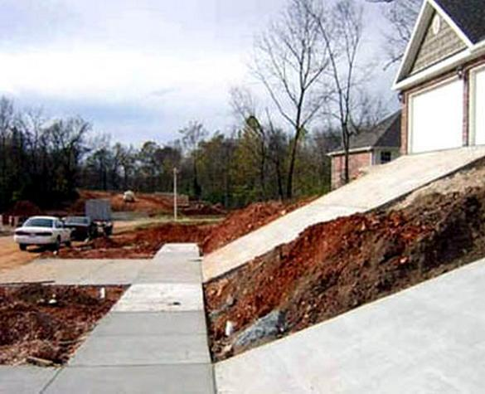
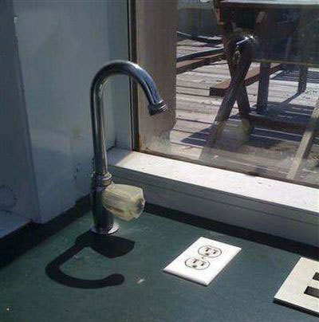
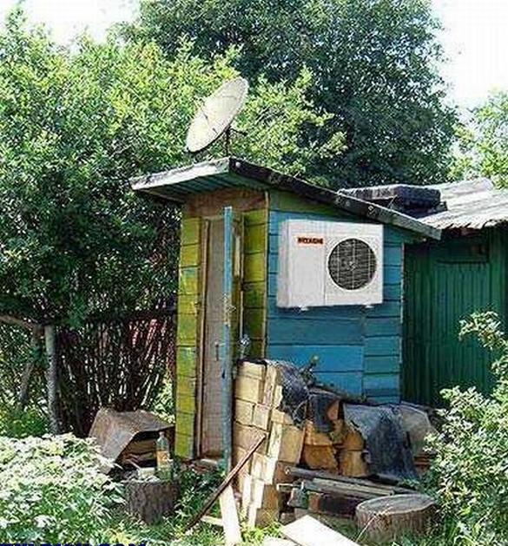
Avoid misery

Slide 8
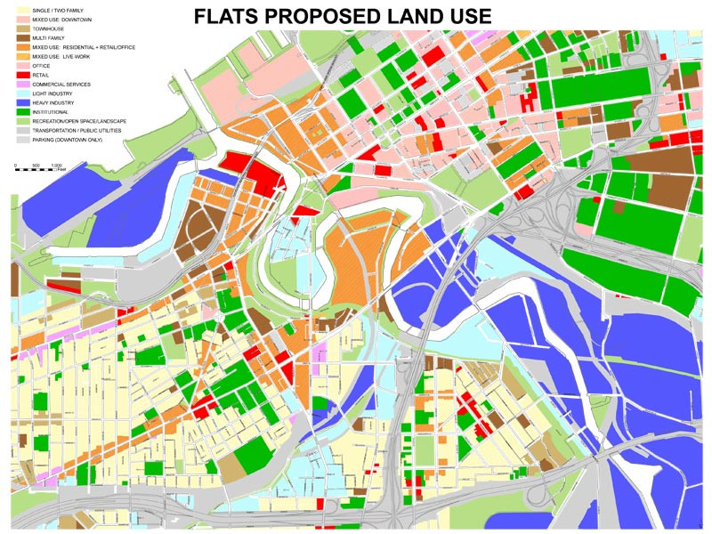


We need to make complexity manageable by
Structuring
  “Land use planning in the digital world”
Abstracting
  Omit all irrelevant information
  Just the essence
Modelling
  Decomposition in components (functional and technical)
  Relations between components
  Principles

Slide 9
IT Infrastructure life-cycle model: overview
Notes:
It’s about the logical ordering and dependencies; not necessarily chronological ordering.
Borrowed from Paul E. Rook (1986) Controlling software projects.

Slide 10
IT Infrastructure life-cycle model: deliverables

Slide 11
IT Infrastructure life-cycle model: methods

Slide 12
Phases and topics
Test
Strategy
Test cases
Test Report
Demand
Supply
Project
Assignment
Requirements
FD
TD
Realization
Production
Functional
Functionality
Components
Hardware
Software
Infrastructure
Business
Problem
Non-functional
Quality
Specs
SLA
Configuration
Risks
Interfaces
Directions
Report
Principles
Procedures
Governance
Prescriptions
Notes:
Functional modeling acts as a pivot between demand and supply.

Slide 13
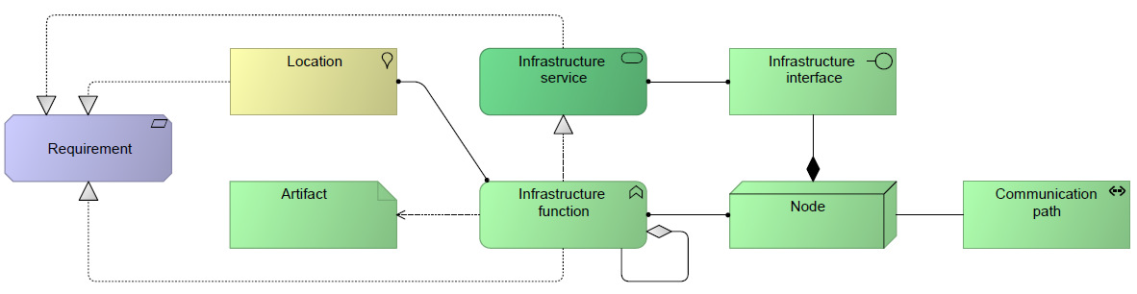
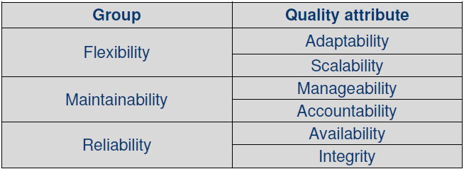
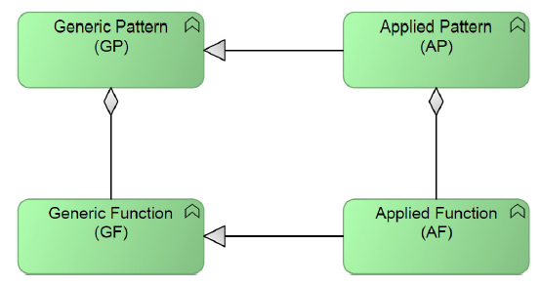
OIAm lectures
According to whitepaper and repository
Three ingredients
  Archimate as modeling language
    Specific infrastructure requirements
  Workflow inspired by Blaauw
    Translate functional design, via technical design to realization
    From generic to specific
  Generic functionality from the OIAm repository with patterns
    http://infra-repository.org
Cookbook/recipe with template documents

Slide 14

Use of template documents
Functional Design
  Applied service overview
  External description
    Business purpose
    Applied service
    Aggregating applied function
    Adjacent/supporting services
  Internal description
    Applied Service
    Aggregated applied functions
    Qualities
  Principles/directions
Technical design
  Global design description
    Layer 3
    Layer 2
  Detail design description
    Components
    Specifications
    Interfaces
  Prescriptions
Notes:
Needed for directing students.
Relation between documents is essential.

Slide 15

Case study: PretScan

Slide 16
Assignment: details
PretScan is a Dutch company that specializes in conducting Full Body Scans. There is expertise in the field of MRI scans, blood tests and cardiac scans.
The government has indicated that all of the scanned patient data must be connected to the EPD (Electronic Patient Dossier) of the patient in a secure manner.
The management of PretScan wants to anticipate to all of these developments. She wants to be the partner of the government to perform full body scans for insureds.

Slide 17
Approach: workflow
Problem & Risk Analyse
Requirements &
Acceptance analyse
Functional Design
Technical Design
Testing & TMAP

Slide 18
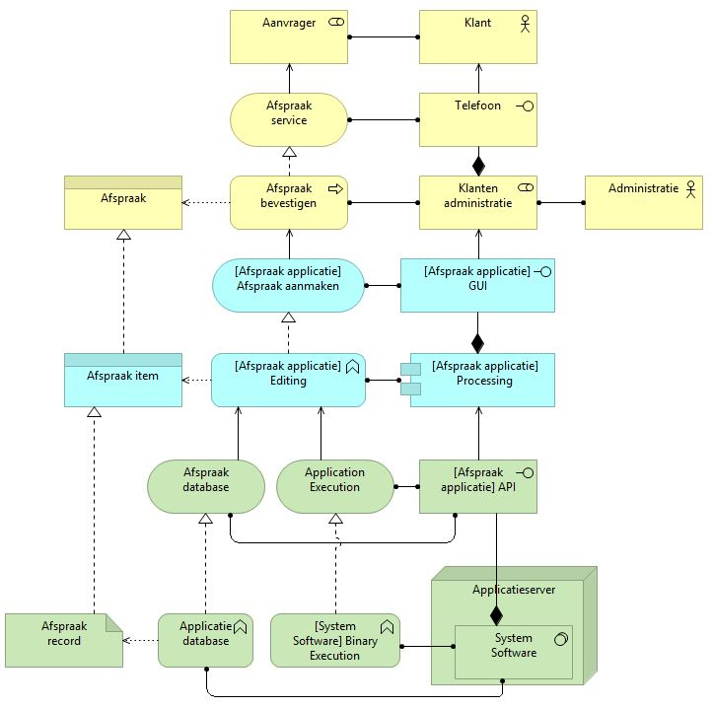
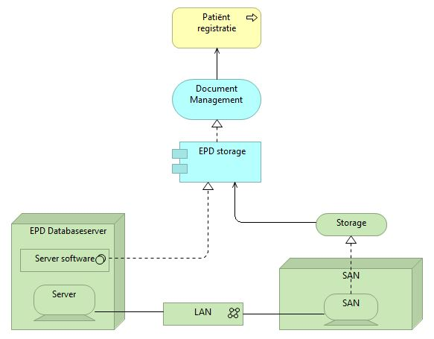
PretScan: Enterprise model(s)
Methods: TOGAF & Archimate

Slide 19
PretScan: Stakeholder analysis

Slide 20
PretScan: Problem & Risk analysis

Slide 21
PretScan: Requirements & Acceptance analyse
Build Requirement Traceability Matrix (RTM)
Classify criteria with Generic Specific Acceptance (GSA) method

Slide 22
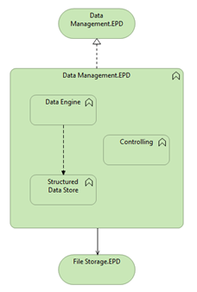
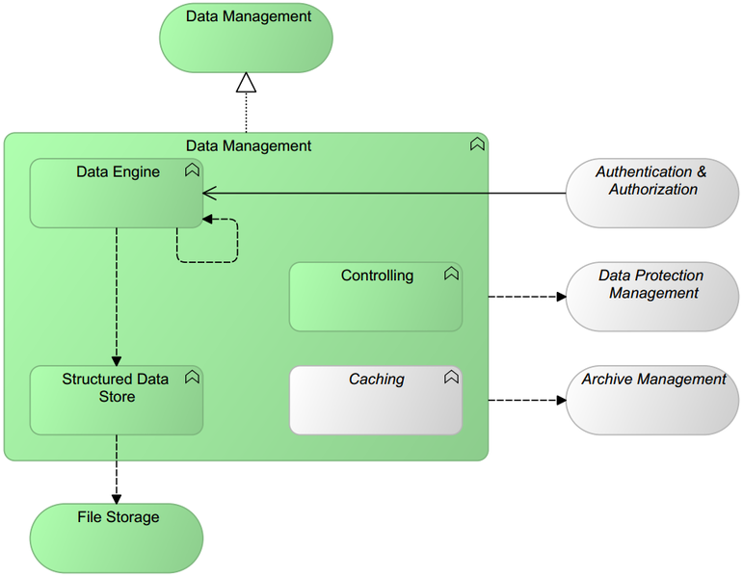
PretScan: Functional Design
From generic to applied
  Pattern: Data Management

Slide 23
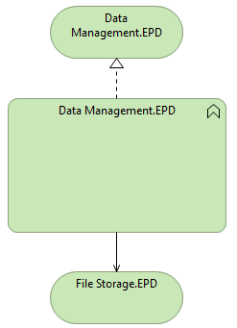
PretScan: Functional Design
Internal view (left), external view (right)
  Pattern: Data Management

Slide 24
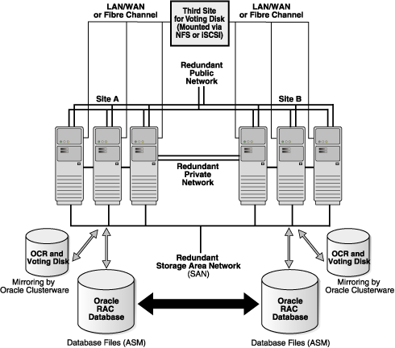
PretScan: Technical Design
Components
Specifications
Interfaces
Function: Data Engine.EPD
Availability by redundancy
Function:
Structured Data Store.EPD

Slide 25
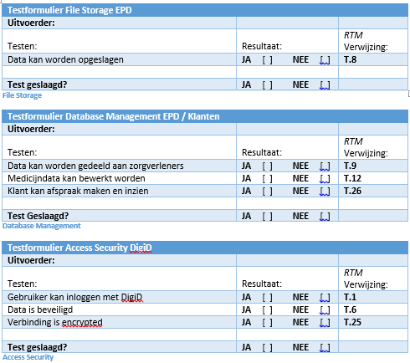
PretScan: Testing & TMAP

Slide 26

Retrospect OIAm: our personal opinion:
Pro’s
  Bridging the gap in interpretation between different stakeholders
  Working with a standard based on proven methods
  Clear view on supply and demand side(s)
  Many roads lead to Rome: Different valid approaches
Cons
  Picking the right pattern and/or function can be challenging
  Many roads lead to Rome: Different valid approaches
  OIAr not always up to date or under construction

Slide 27

OIAm wishlist
Technical Design template based on OIAm’s vision
  OIAr for technical design
OIAr complete & stable
Simplified view for stakeholders
Book describing OIAm
Tutorials on using OIAm
Elaborated case that proofs benefits of OIAm

Slide 28

Summary
Studying Infrastructure Design & Security @ Windesheim
Pretscan case for students
OIAm recommendations

Slide 29

Shameless advertorial
Wanting to learn and apply OIAm in your organization?
Hire a group of students for an IT infrastructure project

Slide 30


